Slide 1
INSURANCE PREMIUM PREDICTION

Slide 2
Objective:
The goal of this project is to give people an estimate of how much they need based on their individual health situation. After that, customers can work with any health insurance carrier and its plans and perks while keeping the projected cost from our study in mind. This can assist a person in concentrating on the health side of an insurance policy rather than the ineffective part.

Slide 3
Dataset:
The dataset is downloaded from Kaggle.
The dataset contains Train.csv and Test.csv files

Slide 4
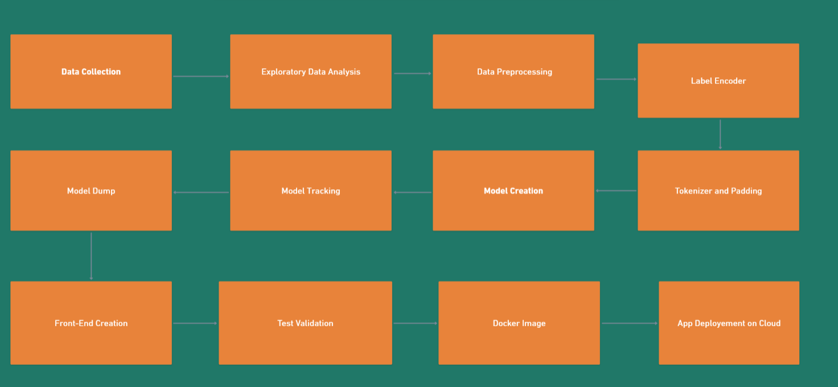
ARCHITECTURE

Slide 5
Data Validation and Data Transformation
Name Validation - Validation of files name as per the DSA.
Number of Columns - Validation of number of columns present in the files are 3 in Train dataset and 2 in Test dataset
Name of Columns - The name of the columns in validation and training are changed according to preference.
Data types of columns - The data types of columns is given in the schema file. It is validated when we insert the files into Database.
Null values in columns - If any of the columns in a file have the values as NULL or missing.

Slide 6
Data Preprocessing
After the raw text is preprocessing, we have to encode our labels to numerical encoding as they were categorically encoded before. For this we are using One-Hot Encoder and Label-Encoder

Slide 7
Model Training
In Model Training we have used different machine learning models.
We got an accuracy of 98% with XGBRegressor Model.

Slide 8
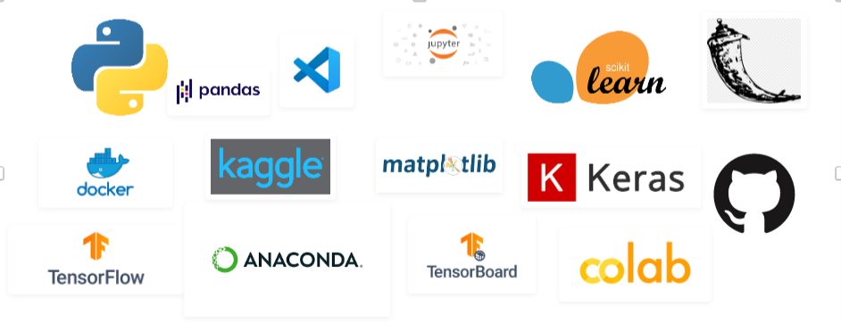
Tools Used

Slide 9
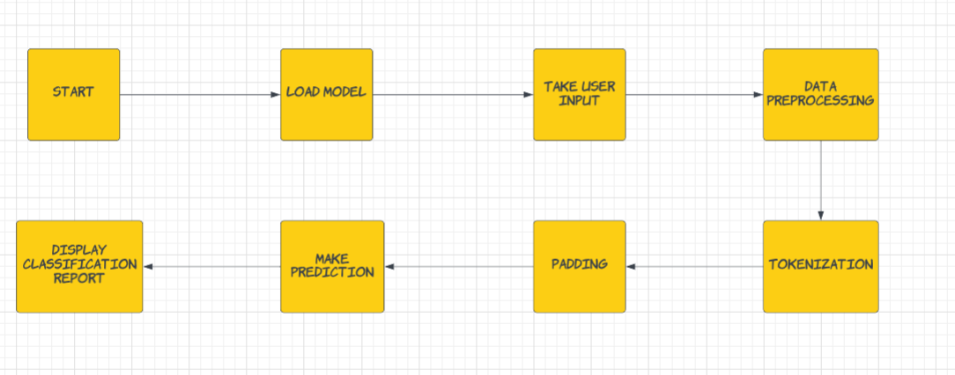
Deployment Process

Slide 10
Q&A
What’s the source of data?
The data for training is provided by the client.
2. What was the type of data?
The data was the combination of numerical and Categorical values.
3. What’s the complete flow you followed in this Project?
Refer slide 4th for better Understanding
4. After the File validation what you do with incompatible file or files which don’t pass the validation?
Files like these are moved to the Achieve Folder and a list of these files has been shared with the client and we removed the bad data folder.

Slide 11
5) How logs are managed?
We are using different logs as per the steps that we follow in
Validation and modelling like File Validation log, Model Training log, Prediction log etc.
6) What techniques were using for data pre-processing?
Removing unwanted attributes
Visualizing relation of independent variables with each other and output variables
Checking and changing Distribution of continuous values
Cleaning data and imputing if null values are present.
Converting Categorical data into numeric values.
Creating a new features according to preferences.

Slide 12
7) How training was done or what models were used?
After data preprocessing and feature engineering, the data is divided into training and validation.
Different algorithms are been used and in only Conv1D is performed the best and it is been used as final model.
8) How prediction was done?
The testing files are shared by the client. Then on the basis of model is loaded and perform prediction. In the end we get the accumulated data of predictions.
9) What are the different stages of deployment?
When the model is ready we build the app using Flask.
After, the app is build then for the deployment Cloud environment is used.

Slide 13
END

